Slide 1

1
INTRODUCTION TO WEB DEVELOPMENT
Code: COMP07009
Week 1 Background
By
Mazhar Malik

Slide 2
Todays Session
In this session, students will be able to understand:
1. Client Server Architecture
2. Request and Response
3. Web Serves
4. ISP
5. Web Hosting
6. Internet vs WWW
7. IDE for Markup and Editors
8. FTP and Examples
9. Components of a Website

Slide 3
Client-Server Architecture
2
All of the machines on the Internet are either servers or clients.
The machines that provide services (like Web servers or FTP servers) to other machines are servers.
And the machines that are used to connect to those services are clients.
A machine may be a client and a server.

Slide 4
Request/Response
3
There are Web servers, e-mail servers, FTP servers and so on serving the needs of Internet users all over the world.
When you connect to www.uws.ac.uk to request a page, you are a user sitting at a client's machine.
You are accessing the University Web server.
The server machine finds the page you requested and sends it to you.

Slide 5
Request/Response
4
Clients that come to a server machine do so with a specific intent, so clients direct their requests to a specific software server running on the server machine.
For example, if you are running a Web browser on your machine, it will want to talk to the Web server on the server machine, not the email server.

Slide 6
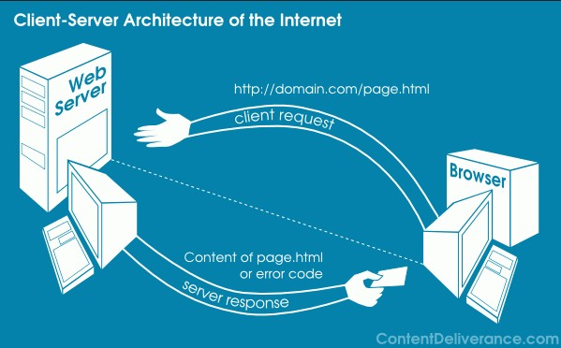
5

Slide 7
Web Servers
6
The collection of web pages is called a web site.
The web site must be published to enable others view the web pages.
The site needs to be copied (uploaded) to a web server to publish the work.
A PC can act as a web server if it is connected to a network.

Slide 8
ISP
7
Internet Service Provider
Allows connection to a network
An ISP provides Internet services
A common Internet service is web hosting
Storing your web site on a public server

Slide 9
Web Hosting
8
A web hosting service is a type of Internet hosting service that allows individuals and organizations to make their website accessible via the World Wide Web.
Web hosts are companies that provide space on a server owned or leased for use by clients, as well as providing Internet connectivity, typically in a data center.

Slide 10
Web Hosting
9
Personal web site hosting typically free, advertisement- sponsored or inexpensive.
Business web site hosting often expensive.
Normally includes email services
Often includes domain name registration
If choosing domain name:
Short, meaningful, clear

Slide 11
Web Host Services
10
Space
Reliability
Uptime
Cost
Backup
Bandwidth or content restriction
Traffic

Slide 12
Examples
11
www.000webhost.com
www.freevirtualservers.com
www.free-webhosts.com

Slide 13
Different Webs
12
Web 1.0
Web 2.0
Web 3.0
The Future!!

Slide 14
Web 1.0
13
1st generation of WWW, created by Tim Berners Lee
One-way communication
Static, Read-only era
Millions of web sites mushroomed during .com boom
Use of framesets and tables to position and align elements on a page

Slide 15
Internet vs WWW
14
Internet
Massive network of networks
Networking structure
Connects millions of computers together globally
WWW
Simply the Web
Way of accessing information over the medium of the Internet

Slide 16
Web 2.0
15
2nd generation WWW
Platform for information sharing
Interactivity and contributions from users
Dynamic, user generated content
Introduction of social networking sites
Eg blogs/wikis

Slide 17
Web 3.0
16
Still evolving
Some definitions vary
Intelligent Web
Web Semantics
Tailor made searches
Deductive reasoning

Slide 18
Comparisons
17
Web 1.0
Unidirectional, “push”
Eg traditional brochure style web sites
Web 2.0
Interactive, “push” + “pull”
Eg social web sites like wikis, Facebook
Web 3.0
Semantic web, immersive

Slide 19
IDEs for Markup
18
HTML text editor to produce web pages
Code-based or WYSIWYG
Able to validate HTML is standards-compliant
Support meta-tags
Preview the page in different browsers
Tabbed editing allows work on multiple pages
An included FTP client is a bonus
Commercial/Free

Slide 20
Examples of Editors
19
Notepad++
KompoZer
Visual Studio
HTML Kit
WebStorm
Blue Griffon

Slide 21
FTP
20
File Transfer Protocol
Simplest way to transfer files between computers, usually across the Internet
Two components are needed:
FTP server listens for incoming connections on TCP port 21
FTP client connects to the server, authenticates and is able to copy
file to and from the server
ie. Uploading from client to server and downloading from server to client

Slide 22
Examples of FTPs
21
Built into the HTML editor
Add-on for browser
FTP Explorer
cuteFTP
FileZilla
smartFTP

Slide 23
Useful Websites
22
w3schools
http://www.w3schools.com
CSS3
http://www.w3schools.com/css3/
Codecademy
https://www.codecademy.com
Validating web pages
http://validator.w3.org/
HowStuffWorks
http://howstuffworks.com
Poor websites
http://www.topdesignmag.com/20-examples-of-bad-web-design/
http://www.webpagesthatsuck.com

Slide 24
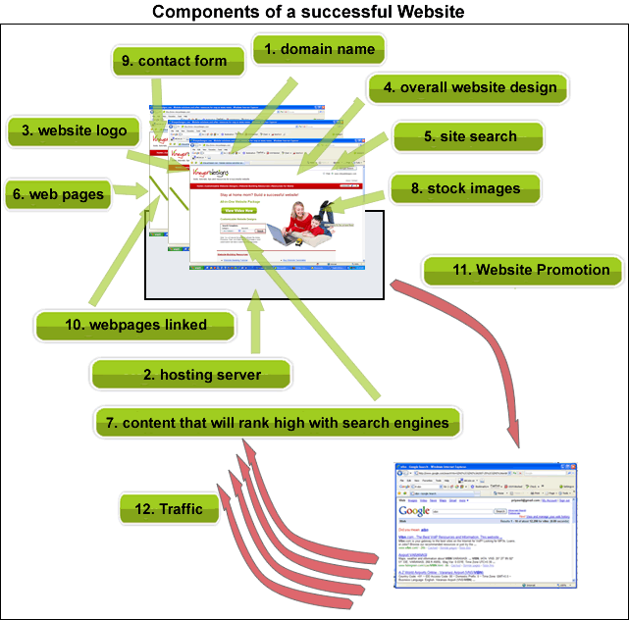
23
http://www.vineyardesigns.com/resources/build_website/index.shtml

Slide 25
1
Any Questions?

